Slide 1
Final Presentation Purpurea
Made by Daniela, Andrew, Eren, Almario, Kaloyan and Gijs.

Slide 2

Contents
1
Domain Understanding
2
Persona
3
Analytic Approach
4
Data Cleaning and Pre-processing
5
Machine Learning Methodology
6
Evaluation and Results
7
Conclusion
8
Future Plan to Improve Work

Slide 3

Domain Understanding
01

Slide 4
The Goal of our Model
Monday
Worst
Optimal
Friday
Suboptimal
Suboptimal
Suboptimal
Tuesday
Wednesday
Thursday

Slide 5
Desired results of this project
Saving time
Decrease costs
Schedule more effectively
Better efficiency
By keeping track of traffic
By saving on gas prices / transportation
By knowing what days will be most suitable to travel
By having a good life-work balance

Slide 6

Persona
02

Slide 7
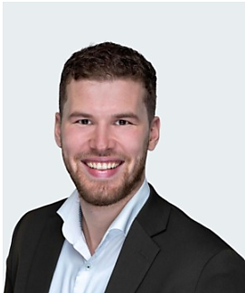
Our Persona
Persona Wouter
Wouter lives in Maarheeze and has an assignment at Alliander in Arnhem.
Roads that contribute to this persona are the A2, A50, A15 and A325.

Slide 8

Analytic Approach
03

Slide 9
Our Approach?
Tackle the problem from multiple angles.
Scraping Data from the internet
Exploring different Machine Learning Models
Gathering Route data

Slide 10


What datasets did we explore?
01
02
03
Weather dataset
Traffic incidents dataset
TomTom dataset
03
Routes dataset
Provided by
Extra datasets used

Slide 11
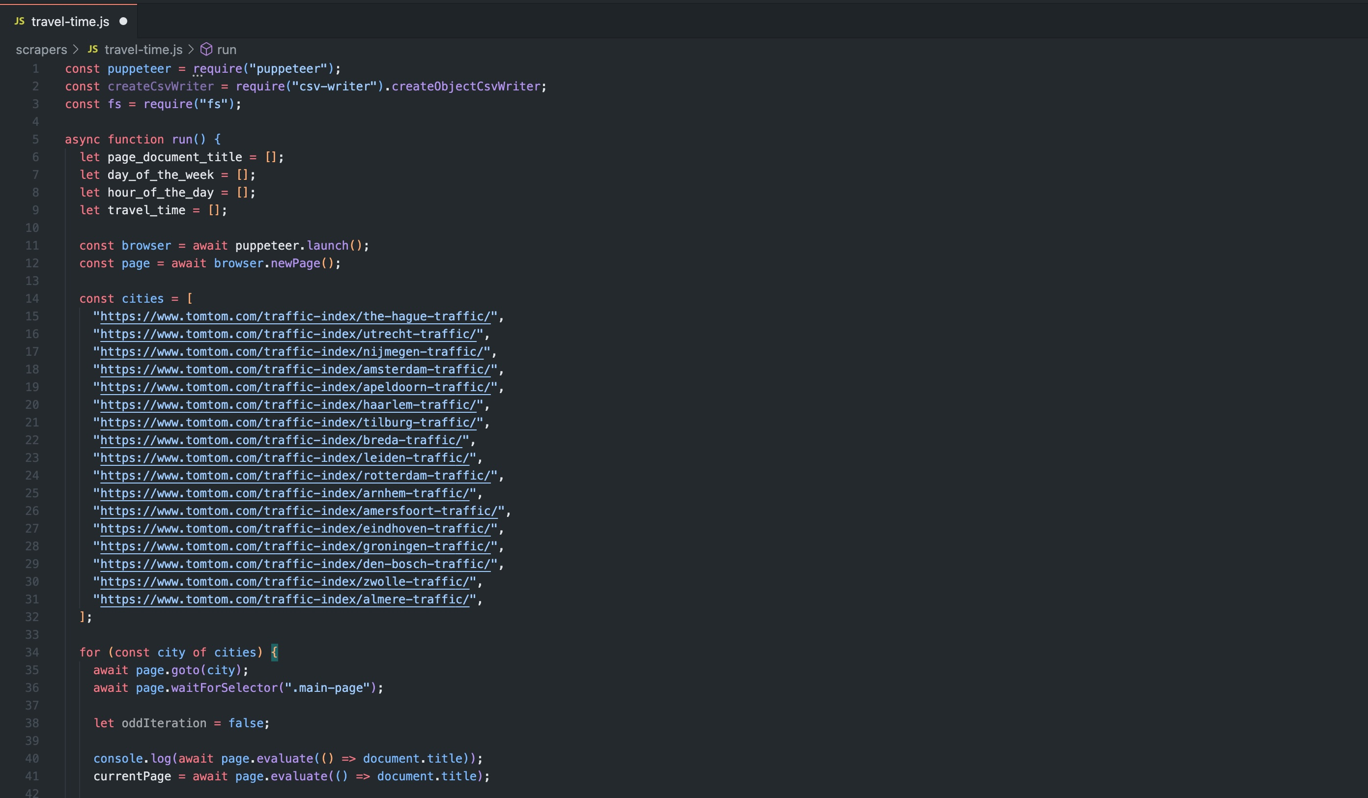
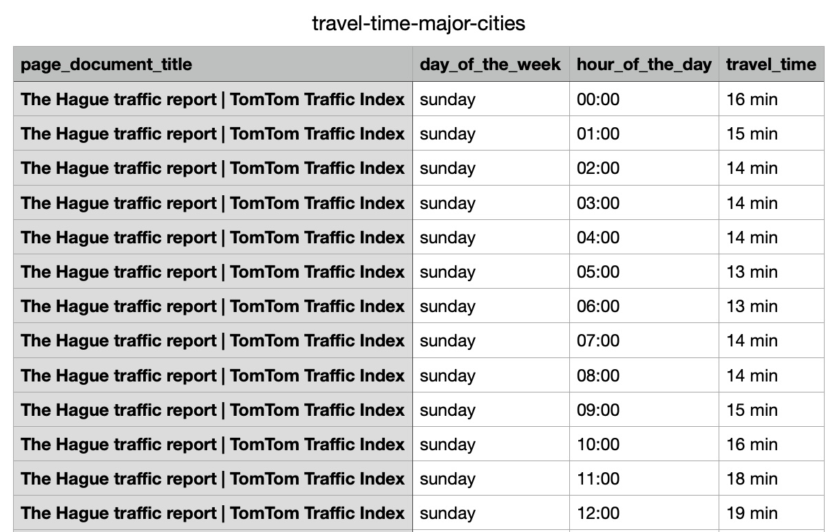

Slide 12
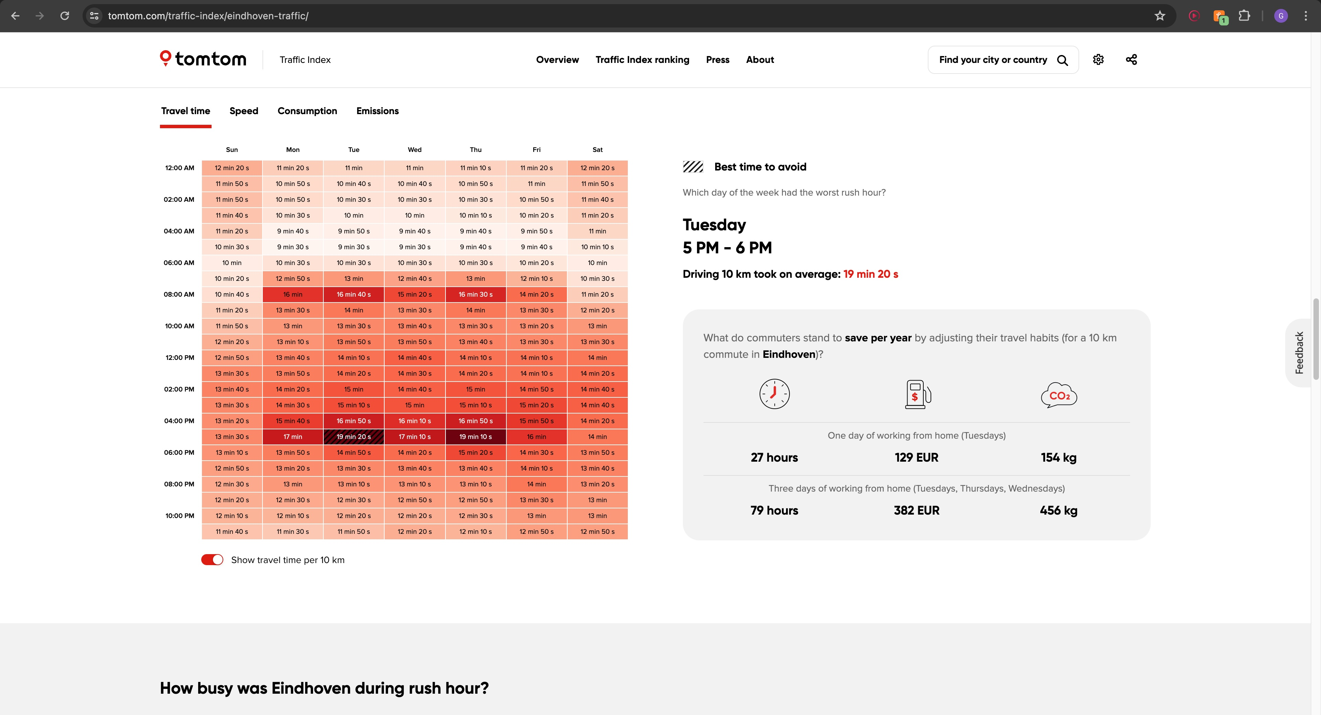
Tom Tom data

Slide 13
Employee Routes
Start | Arrival | Route 1 | Route 2 | Route length (km) | Speed limit (km/h) | Travel time
client | home | A50 | A2 | 108 | 100 | 64,8
home | client | A2 | A50 | 108 | 100 | 64,8
home | client | A50 | - | 108 | 100 | 64,8
client | home | A50 | - | 110 | 100 | 66
…

Slide 14

Data Cleaning and Pre-processing
04

Slide 15
First steps
Data Understanding
Data Joining
Traffic + weather
Data analyzing
Raw Data
Ready for modelling
Make plots that will help understanding the patterns, if there are some
Bring Data to the Same Hour Scale
Filter on Needed Weather Stations
Categorize the Incidents
Drop Non-Useful Days & Hours
Fill the NaN values
Check the provided datasets
Translating and renaming the columns

Slide 17
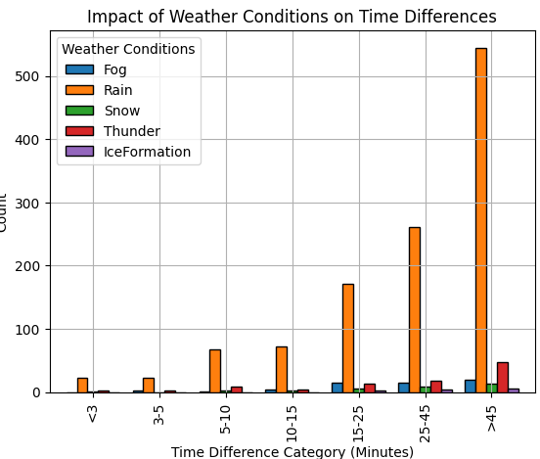
Impact of Weather Conditions on Time Differences

Slide 18
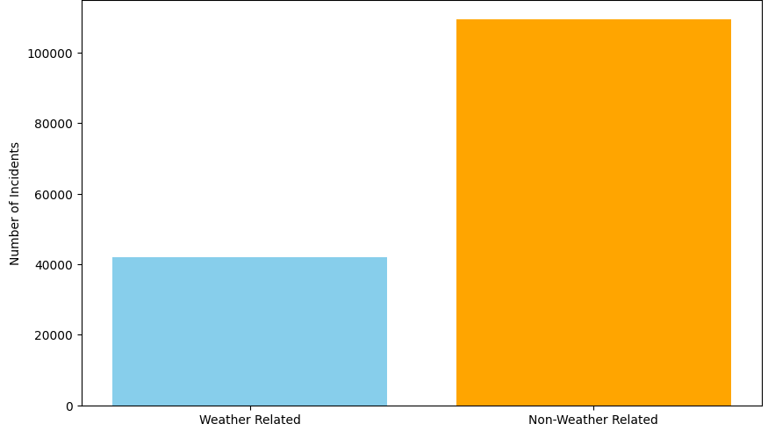
Weather and Non-Weather-Related Incidents

Slide 19
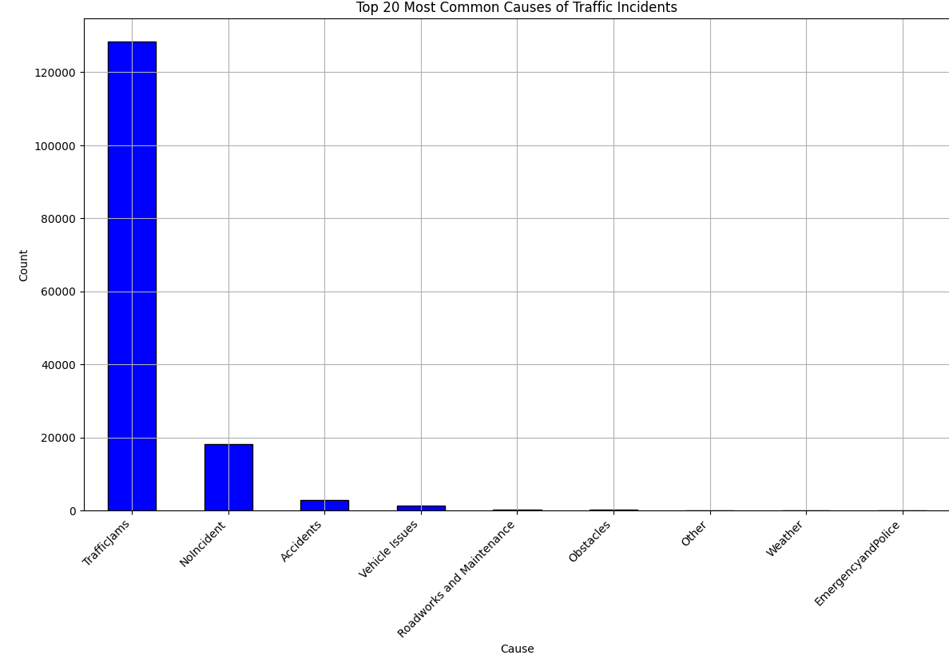
Top Most Common Causes of Traffic Incidents

Slide 20
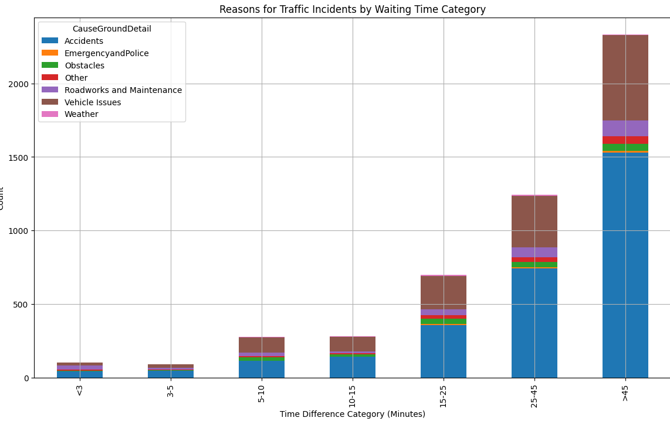
Reasons for Traffic Incidents by Waiting Time

Slide 21
128,286
Phantom Jams
Stuck in traffic with no visible culprit
85%

Slide 22
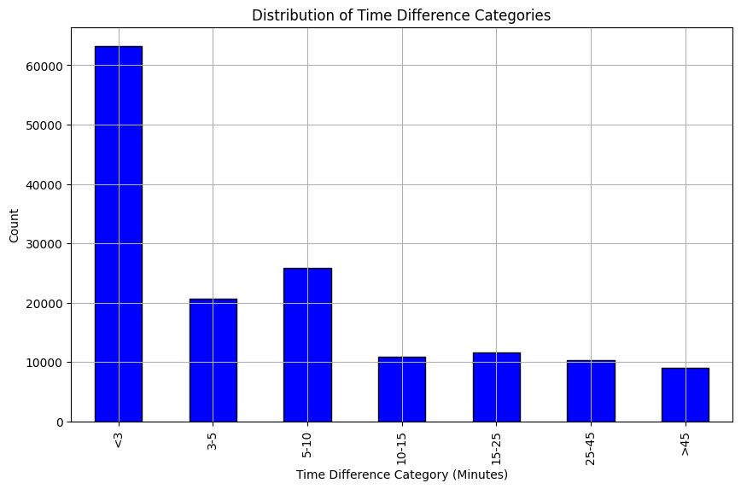
Distribution of Time Categories

Slide 23
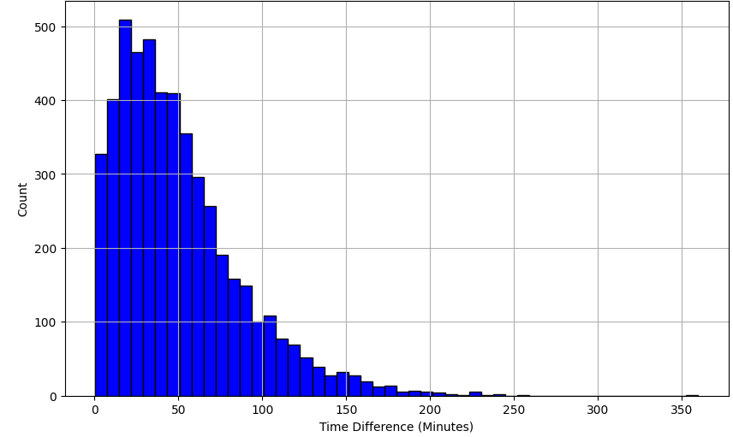
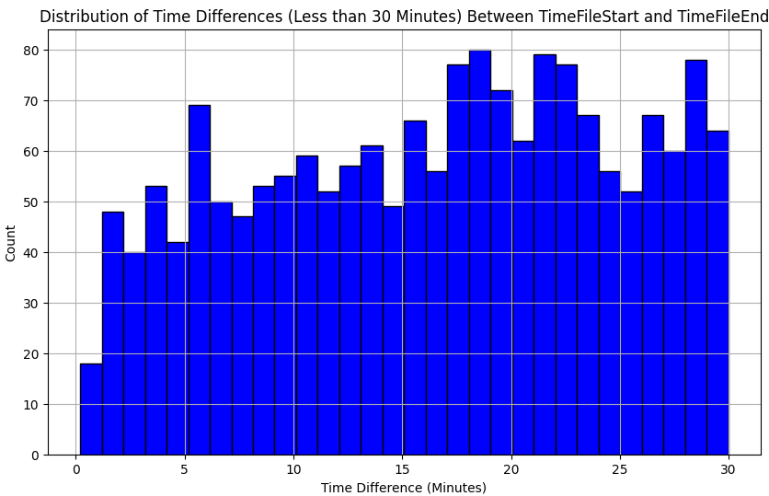
Time Difference Distribution

Slide 24
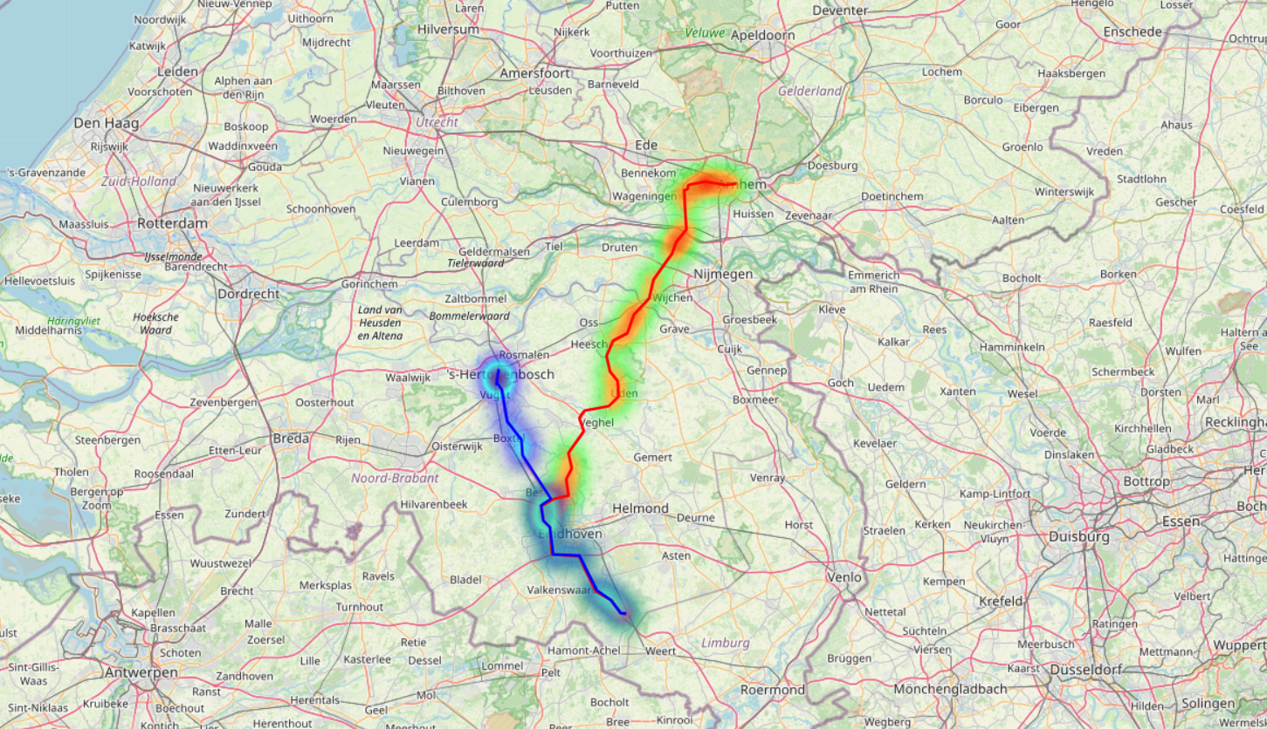
Incidents Heat-Map

Slide 25

Machine Learning Methodology
05

Slide 26
A50
A2 + A50
Route to Office
Routes to Client Office
Used Routes
A2
A2 + A325
Maarheeze
to
's-Hertogenbosch
Maarheeze
to
Arnhem

Slide 27

Models Used
01
Gradient Boosting
02
RandomForest Regressor
03
XGBoostRegressor

Slide 28

Evaluation and Results
06

Slide 29
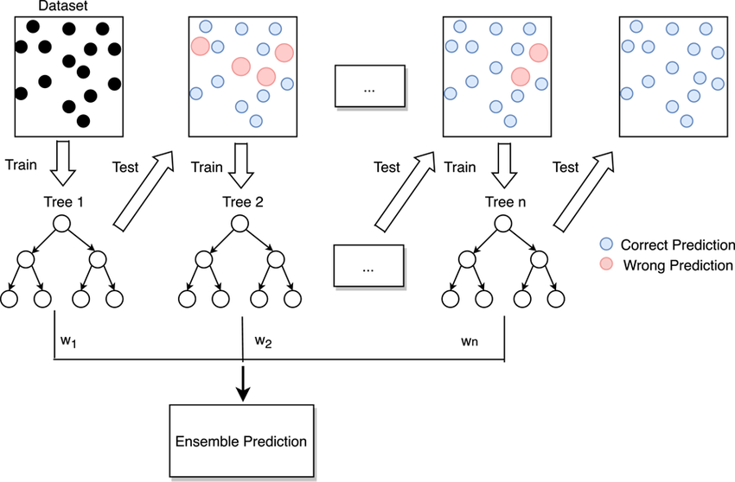
Gradient Boosting
^{0.84}
R²
R-squared
217.02
14.73
MSE
Mean Squared Error
RMSE
Root Mean Squared Error

Slide 30
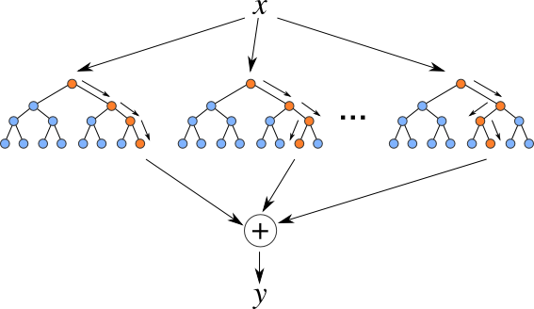
RandomForest Regressor
^{0.99}
R²
R-squared
20.20
4,5
MSE
Mean Squared Error
RMSE
Root Mean Squared Error

Slide 31
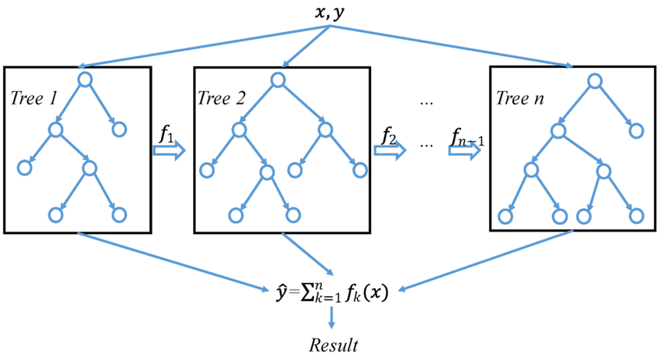
XGBoostRegressor
^{0.91}
R²
R-squared
131,92
11,48
MSE
Mean Squared Error
RMSE
Root Mean Squared Error

Slide 32
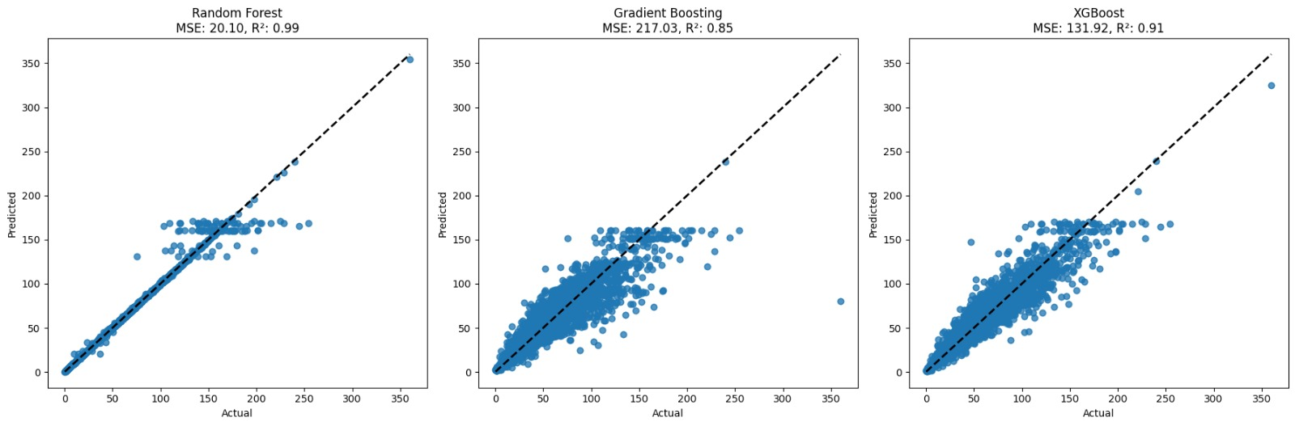
Comparison Between ML Algorithms

Slide 33
Why XGBoost ?
Suitable for accurately predicting waiting times in real-world traffic scenarios
Ability to handle non linear relations (Route, traffic severity and waiting time).
Built-in regularization which is helpful to reduce overfitting.
Gave better results compared to other machine learning algorithms.

Slide 34
Feature Selection
Features = Route Number, Traffic Severity Normalized (File Severity), Day Of the Week
Target = Waiting Time In Trafic (Time Difference Minutes)
​
Base Travel Time = Total Lenght(km) / Speed Limit(km/h)
Total Travel Time = Base Travel Time + Predicted Waiting Time

Slide 35

Demo Time

Slide 36

Conclusion
07

Slide 37
Our model
Strengths
Weaknesses
Best days to travel
What is the expected of delay in the traffic
Schedule planner application
User friendly and simple web page interface
It was not possible to predict the exact hours of traveling
The model prediction encounters only the highways

Slide 38

Future Plan to Improve Work
08

Slide 39



Things to improve in this model
Combine different machine learning methods to improve the prediction
Adapt the model to accommodate various personas
Integrate TomTom City Data
Make/Find a dataset/live data that would represent the situation on the roads better

Slide 40
Any questions?

